Slide 1
Knapsack and graph optimization problems

Slide 2
OPTIMIZATION PROBLEMS
In general, an optimization problem has two parts
1. An objective function that is to be maximized or minimized. For example, the airfare between Boston and Istanbul.
2.A set of constraints(possibly empty) that must be honored. For example, an upper bound on the travel time.

Slide 3
Algorithm Approaches to Optimize Problems
Greedy Approach (Knapsack Problem)
Divide Conquer (Sorting)
Dynamic Programming (Fibonacci,
combination)
Backtracking(n-queen problem)

Slide 4
Greedy Approach
A greedy algorithm, as the name suggests, always makes the choice that looks best at that moment. That is, it makes a locally optimal choice in the hope that this choice will lead to a globally optimal solution.
Now the question is how to decide which choice is the best (or optimal)?? For that objective function needs to be optimized (either maximized or minimized) at the given point. Greedy algorithm makes greedy choices at each step such that the objective function is optimized.
Example,
      Travelling Sales Man Problem
      Knapsack Problem

Slide 5
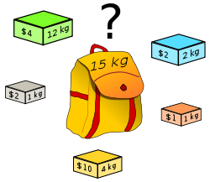

Slide 6
KNAPSACK PROBLEM
Given a set of items, each with a weight and a value, determine the number of each item to include in a collection so that the total weight is less than or equal to a given limit and the total value is as large as possible. It derives its name from the problem faced by someone who is constrained by a fixed-size knapsack and must fill it with the most valuable items.

Slide 7
Algorithm Approach to Optimize Problems
Greedy Approach (Knapsack Problem)
Divide Conquer (Sorting)
Dynamic Programming (Fibonacci, combination)
Backtracking(n-queen problem)

Slide 8
Divide Conquer
A divide and conquer algorithm works by recursively breaking down a problem into two or more sub-problems of the same or related type, until these become simple enough to be solved directly. The solutions to the sub-problems are then combined to give a solution to the original problem.
Example,
  Merge Sort
  Binary Search
  Quick Sort

Slide 9
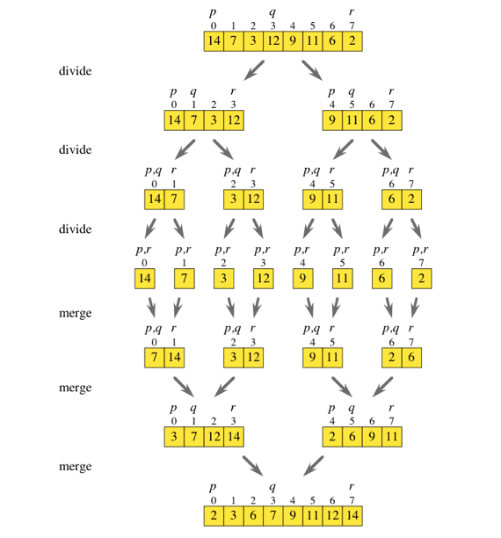

Slide 10
Algorithm Approach to Optimize Problems
Greedy Approach (Knapsack Problem)
Divide Conquer (Sorting)
Dynamic Programming (Fibonacci, combination)
Backtracking(n-queen problem)

Slide 11
Dynamic Programming
The idea is very simple, If you have solved a problem with the given input, then save the result for future reference, so as to avoid solving the same problem again.. shortly 'Remember your Past' :) . If the given problem can be broken up in to smaller sub-problems and these smaller sub-problems are in turn divided in to still-smaller ones, and in this process, if you observe some over-lapping sub-problems, then its a big hint for DP.
Examples,
  Fibonacci Sequence
  Factorial (Using Dictionaries we have done)
  Longest Common Subsequence

Slide 12
Algorithm Approach to Optimize Problems
Greedy Approach (Knapsack Problem)
Divide Conquer (Sorting)
Dynamic Programming (Fibonacci, combination)
Backtracking(n-queen problem)

Slide 13
Backtracking
We start with one pos­si­ble move out of many avail­able moves and try to solve the prob­lem if we are able to solve the prob­lem with the selected move then we will print the solu­tion else we will back­track and select some other move and try to solve it. If none if the moves work out we will claim that there is no solu­tion for the problem.
Example,
N-Queen Problem

Slide 14
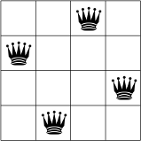
The 4-Queens Problem consists of placing four queens on a
4 x 4 chessboard so that no two queens can capture each other. That is, no two queens are allowed to be placed on the same row, the same column or the same diagonal.

Slide 15
SOLVING KNAPSACK PROBLEM USING GREEDY APPRAOCH

Slide 16
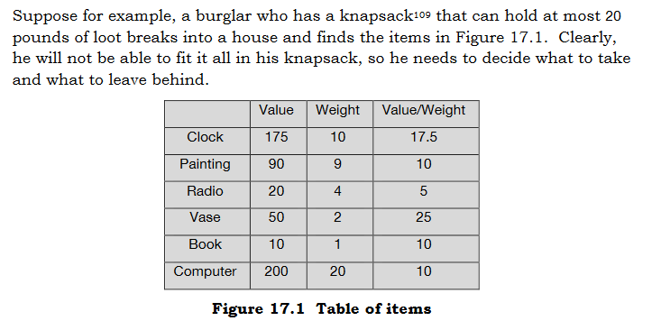

Slide 17
Solution ???
The simplest way to find an approximate solution to this problem is to use a greedy algorithm
The thief would choose the best item first, then the next best, and continue until he reached his limit.
What is BEST ITEM??

Slide 18
What is BEST ITEM??
most valuable ?
or
the least heavy ?
or
the item with the highest value-to-weight ratio ?

Slide 19
If he chose highest value, he would leave with just the computer, which he could fence for $200
If he chose lowest weight, he would take, in order, the book, the radio, the vase, and the painting—which would be worth a total of $170.
if he decided that best meant highest value-to-weight ratio, he would start by taking the vase and the clock. That would leave three items with a value-to-weight ratio of 10, but of those only the book would still fit in the knapsack. After taking the book, he would take the remaining item that still fit, the radio. The total value of his loot would be $255.

Slide 20
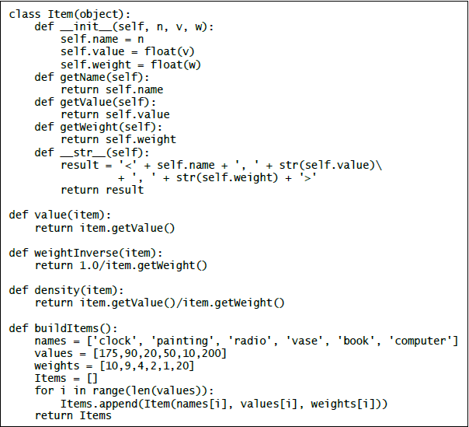
0…

Slide 21
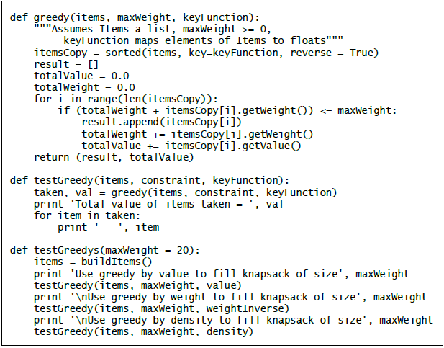

Slide 22
